Slide 1
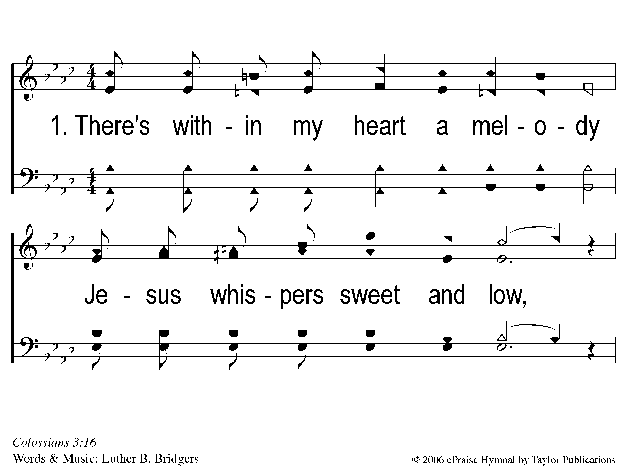
1-1 He Keeps Me Singing
He Keeps Me Singing
163

Slide 2
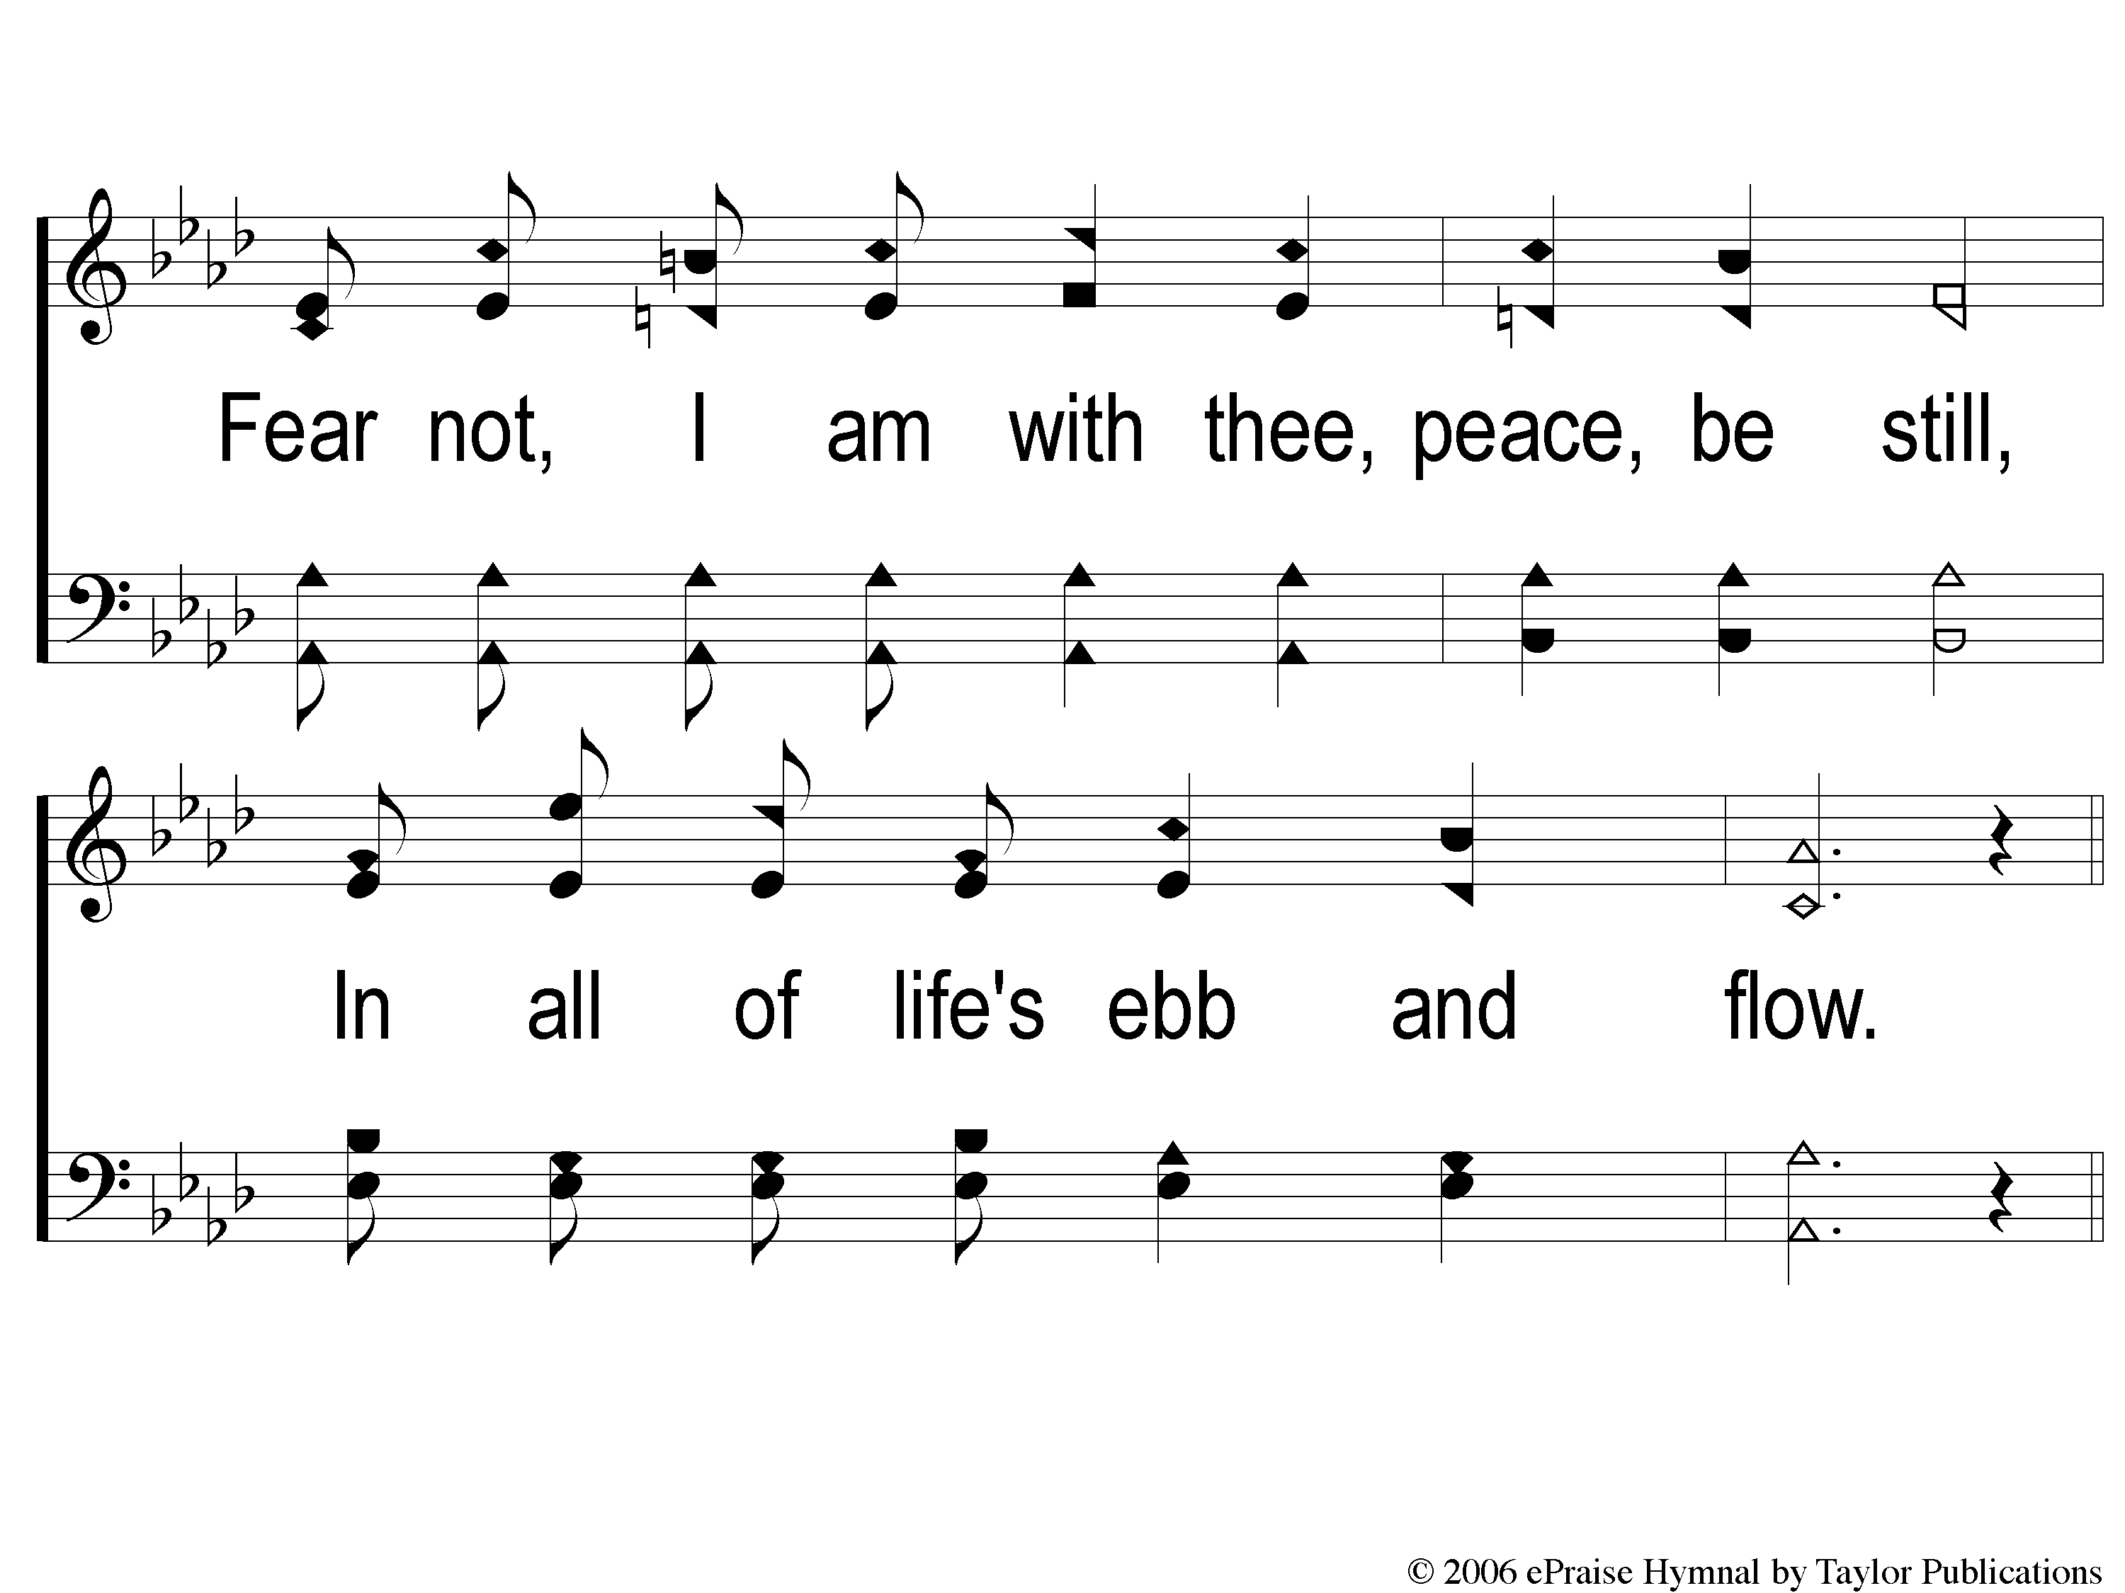
1-2 He Keeps Me Singing
He Keeps Me Singing
163

Slide 3
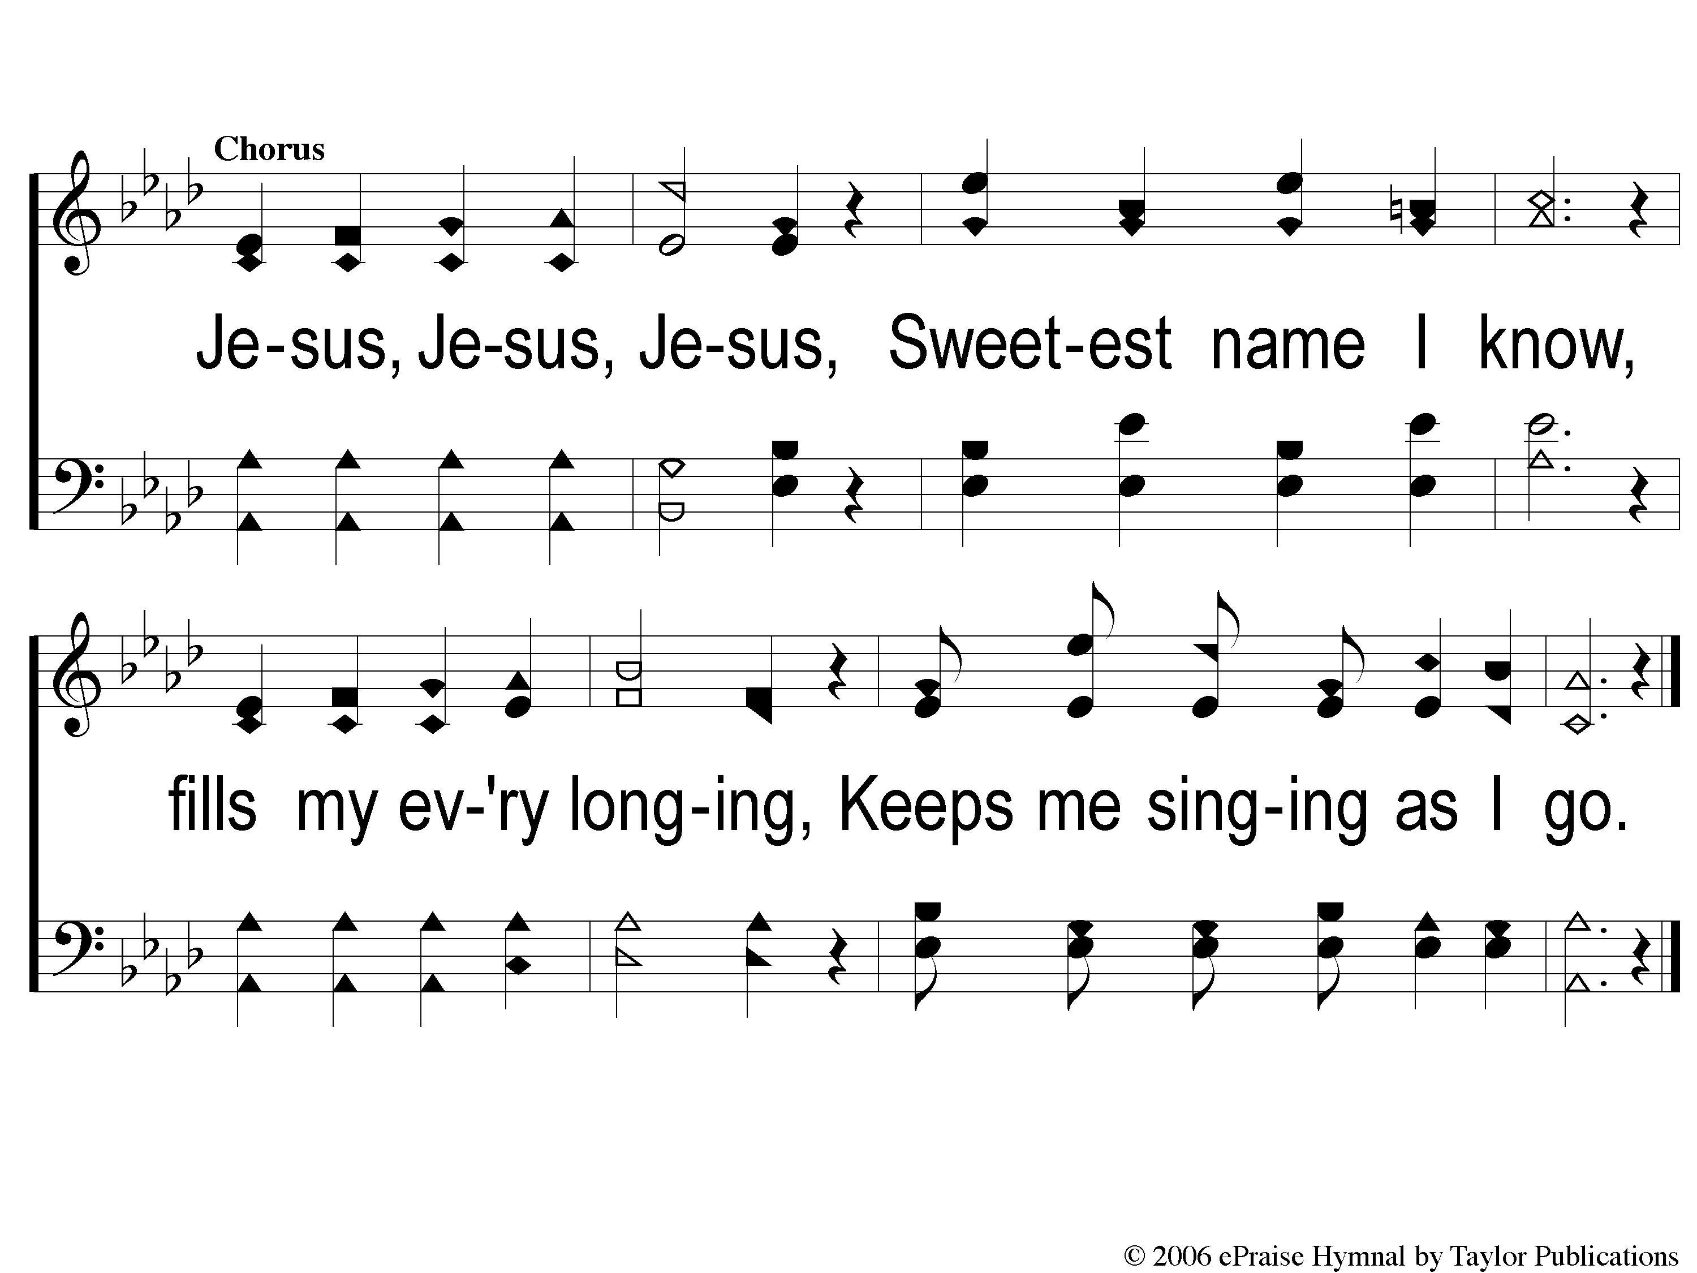
C-1 He Keeps Me Singing
He Keeps Me Singing
163

Slide 4
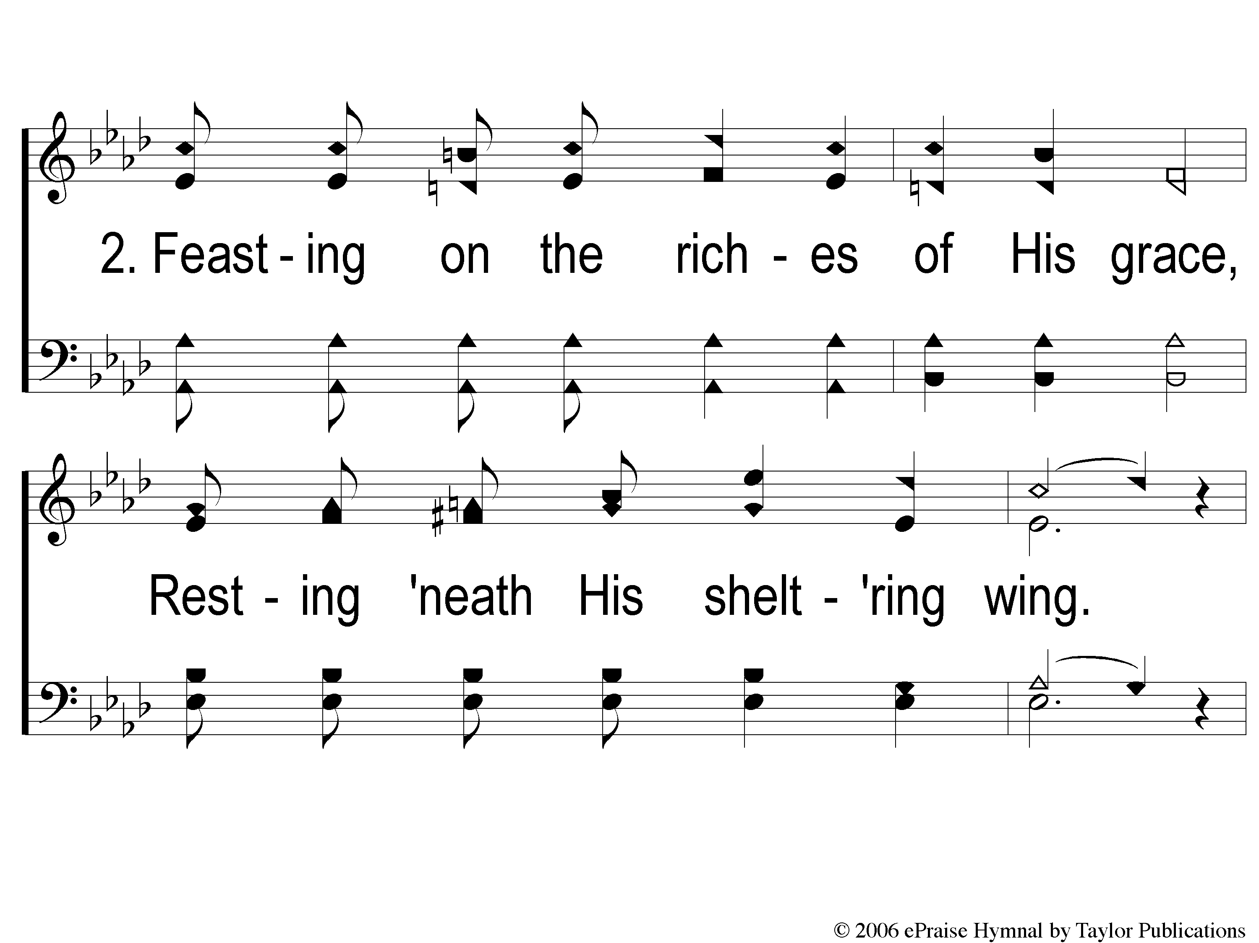
2-1 He Keeps Me Singing
He Keeps Me Singing
163

Slide 5
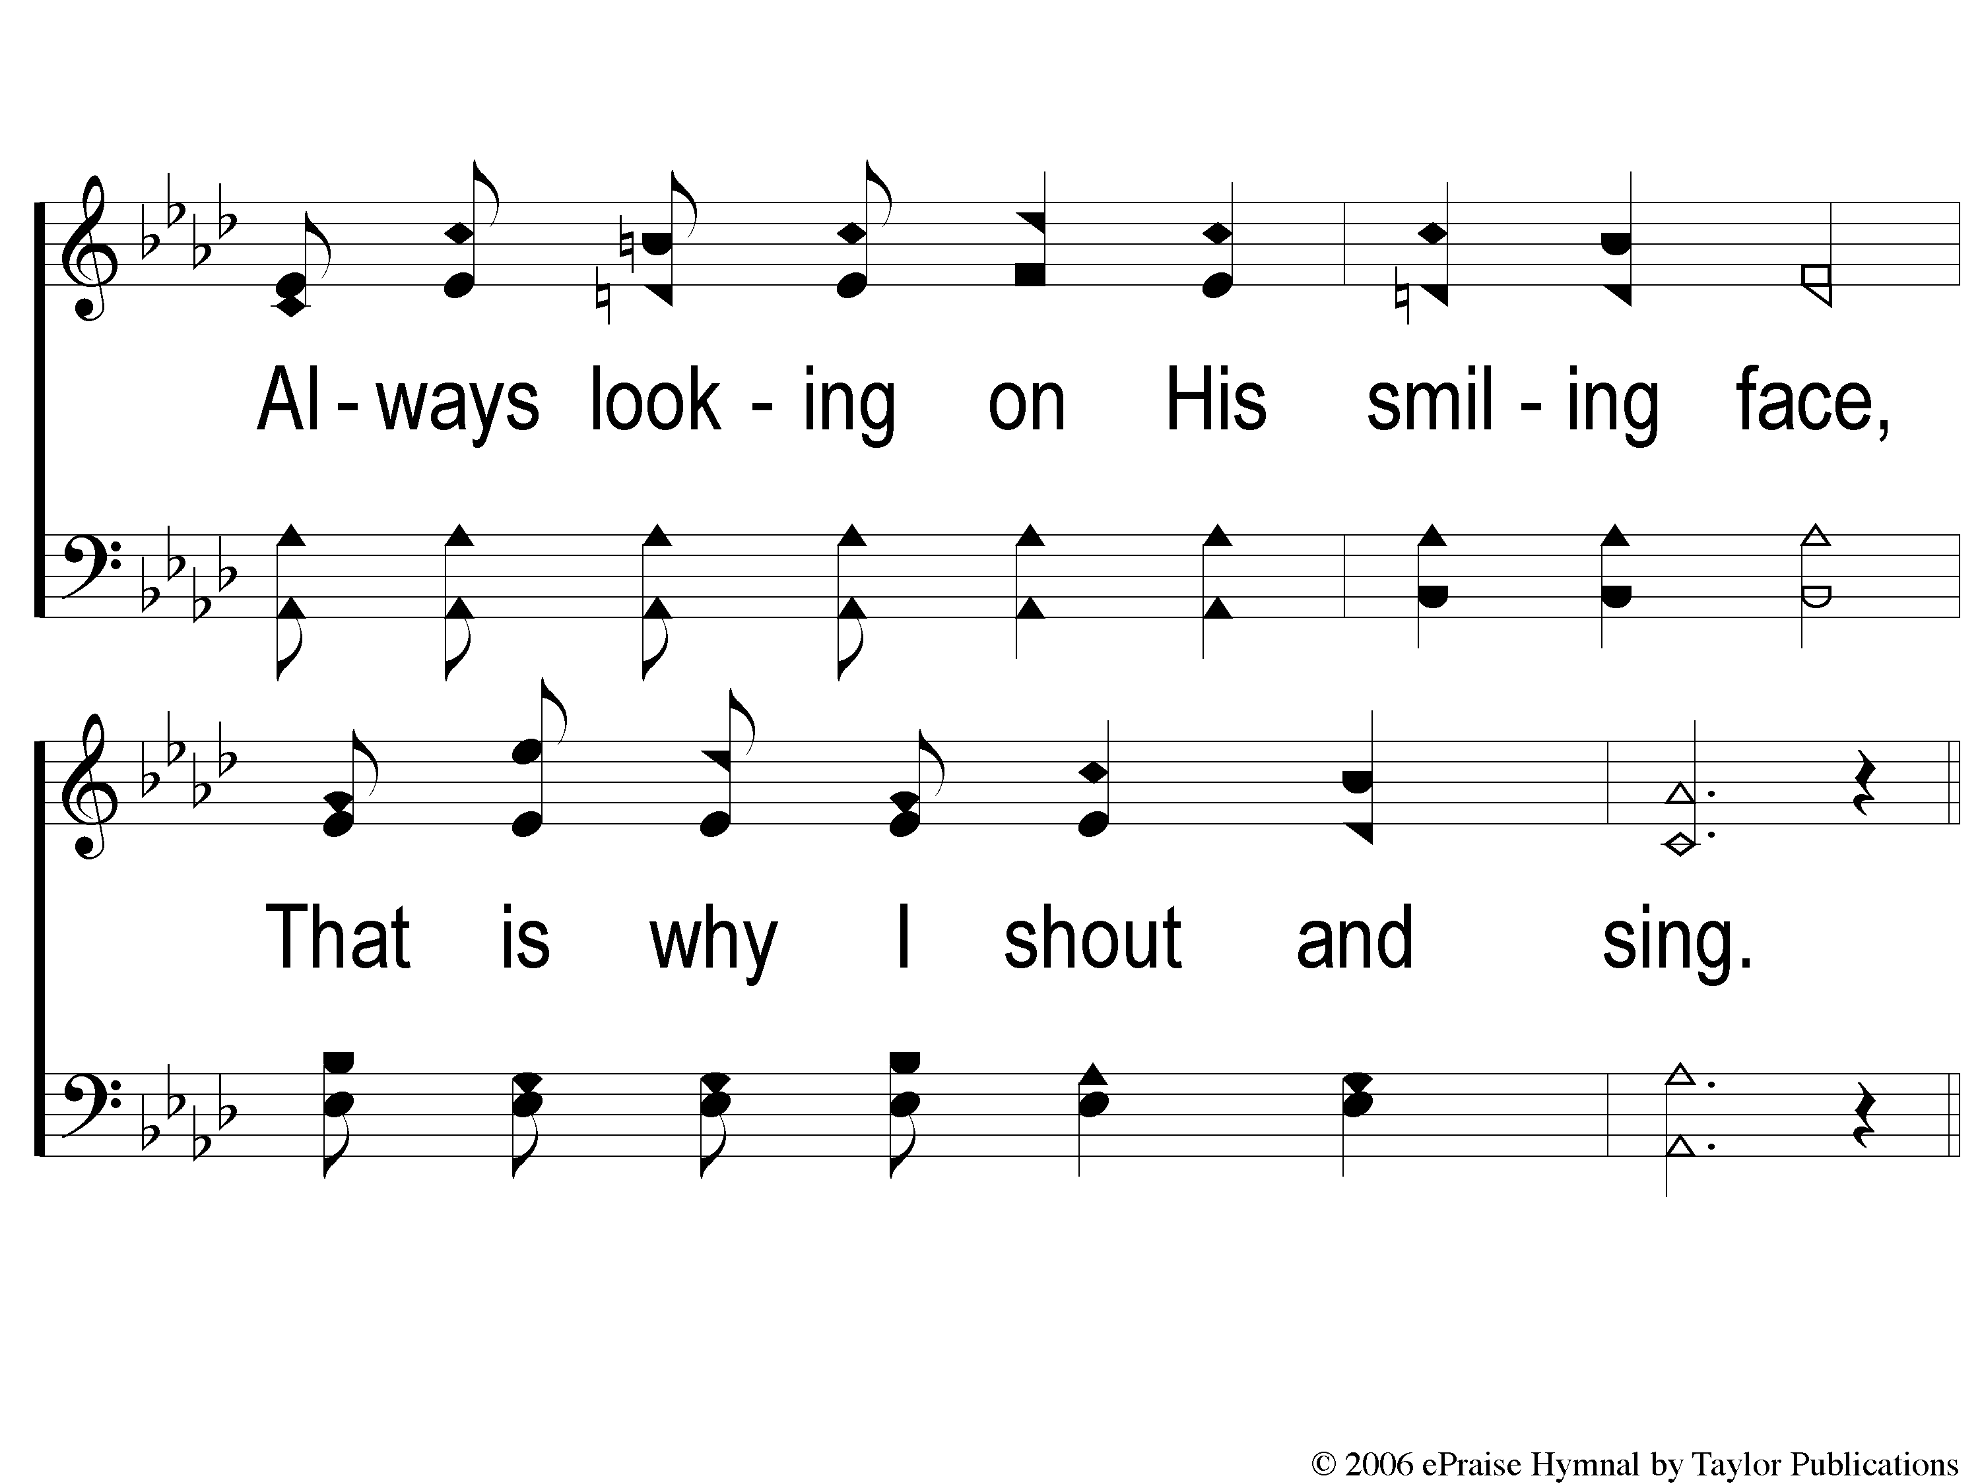
2-2 He Keeps Me Singing
He Keeps Me Singing
163

Slide 6
C-1 He Keeps Me Singing
He Keeps Me Singing
163

Slide 7
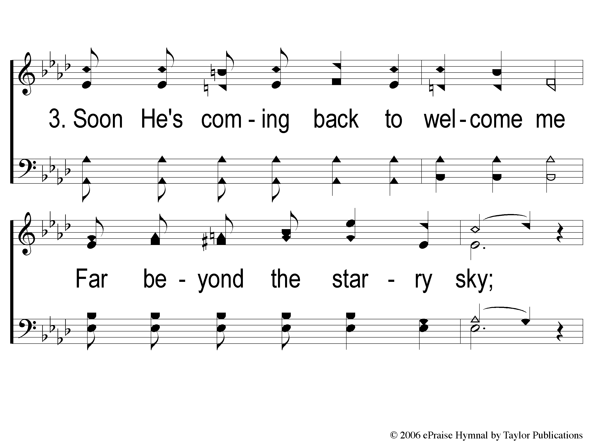
3-1 He Keeps Me Singing
He Keeps Me Singing
163

Slide 8
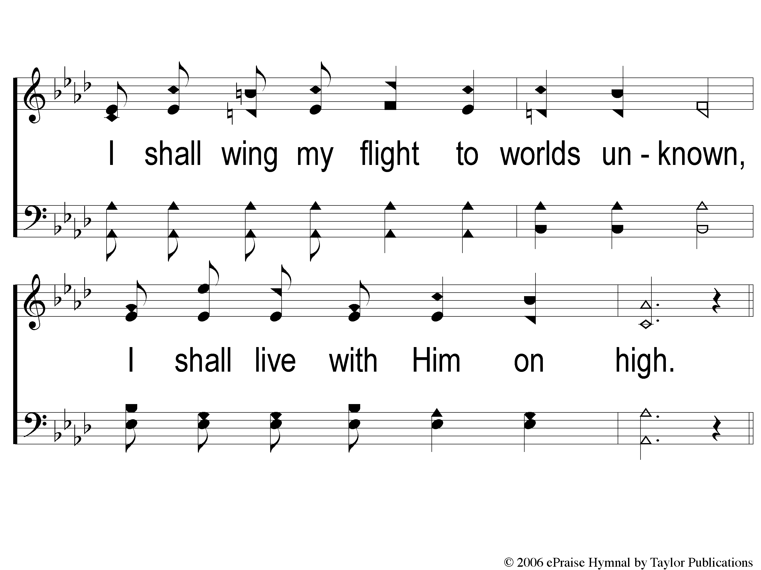
3-2 He Keeps Me Singing
He Keeps Me Singing
163

Slide 9
C-1 He Keeps Me Singing
He Keeps Me Singing
163

